Slide 1
Complexity of Merge Sort Algorithm
Course Code: CSC2211
Course Title: Algorithms
Dept. of Computer Science
Faculty of Science and Technology
Lecturer No: |  | Week No: |  | Semester:
Lecturer: | Nyme Ahmed [nyme.ahmed@aiub.edu]

Slide 2
Lecture Outline
1. Sorting Algorithms
Merge Sort

Slide 3
Divide and Conquer
Recursive in structure
Divide the problem into independent sub-problems that are similar to the original but smaller in size
Conquer the sub-problems by solving them recursively. If they are small enough, just solve them in a straightforward manner. This can be done by reducing the problem until it reaches the base case, which is the solution.
Combine the solutions of the sub-problems to create a solution to the original problem

Slide 4
Merge Sort
Sorting Problem: Sort a sequence of n elements into non-decreasing order.
Divide: Divide the n-element sequence to be sorted into two subsequences of n/2 elements each
Conquer: Sort the two subsequences recursively using merge sort.
Combine: Merge the two sorted subsequences to produce the sorted answer.

Slide 5
Merge(L,R,A) {
nL = length(L)
nR = length(R)
i= j = k = 0
while(i< nL && j< nR) {
if(L[i] <= R[j]) {
A[k] = L[i]
i= i+1
}
else {
A[k] = R[j]
j= j+1
}
k= k+1
}
while( i<nL) {
A[k] = L[i]; i=i+1; k=k+1;
}
while (j<nR) {
A[k] = R[i]; j=j+1; k=k+1;
}
}
n*c0+ n*c1+n*c2+ c4
=n*(c0+c1+c2) + c4
=n*c3 + c4
=n (Linear time)
Because of having no nested loops

Slide 6
nL = length(L)
nR = length(R)
i= j = k = 0
i=0
j=0
L
14
23
45
98
R
6
33
42
67

Slide 7
while(i< nL && j< nR) {
If(L[i] <= R[j]) {
A[k] = L[i]
i= i+1
}
else {
A[k] = R[j]
j= j+1
}
k= k+1
}
i=0
j=0
L
14
23
45
98
R
6
33
42
67
A

Slide 8
while(i< nL && j< nR) {
If(L[i] <= R[j]) {
A[k] = L[i]
i= i+1
}
else {
A[k] = R[j]
j= j+1
}
k= k+1
}
i=0
j=1
L
14
23
45
98
R
6
33
42
67
A
6
k=0

Slide 9
while(i< nL && j< nR) {
If(L[i] <= R[j]) {
A[k] = L[i]
i= i+1
}
else {
A[k] = R[j]
j= j+1
}
k= k+1
}
i=1
j=1
L
14
23
45
98
R
6
33
42
67
A
6
14
k=1

Slide 10
while(i< nL && j< nR) {
If(L[i] <= R[j]) {
A[k] = L[i]
i= i+1
}
else {
A[k] = R[j]
j= j+1
}
k= k+1
}
i=2
j=1
L
14
23
45
98
R
6
33
42
67
A
6
14
23
k=2

Slide 11
while(i< nL && j< nR) {
If(L[i] <= R[j]) {
A[k] = L[i]
i= i+1;
}
else {
A[k] = R[j]
j= j+1
}
k= k+1
}
i=2
j=2
L
14
23
45
98
R
6
33
42
67
A
6
14
23
33
k=3

Slide 12
while(i< nL && j< nR) {
If(L[i] <= R[j]) {
A[k] = L[i]
i= i+1
}
else {
A[k] = R[j]
j= j+1
}
k= k+1
}
i=2
j=3
L
14
23
45
98
R
6
33
42
67
A
6
14
23
33
42
k=4

Slide 13
while(i< nL && j< nR) {
If(L[i] <= R[j]) {
A[k] = L[i]
i= i+1
}
else {
A[k] = R[j]
j= j+1
}
k= k+1
}
i=3
j=3
L
14
23
45
98
R
6
33
42
67
A
6
14
23
33
42
45
k=5

Slide 14
while(i< nL && j< nR) {
If(L[i] <= R[j]) {
A[k] = L[i]
i= i+1
}
else {
A[k] = R[j]
j= j+1
}
k= k+1
}
i=3
j=4
L
14
23
45
98
R
6
33
42
67
A
6
14
23
33
42
45
67
k=6

Slide 15
while(i< nL && j< nR) {
If(L[i] <= R[j]) {
A[k] = L[i]
i= i+1
}
else {
A[k] = R[j]
j= j+1
}
k= k+1
}
i=3
j=4
L
14
23
45
98
R
6
33
42
67
A
6
14
23
33
42
45
67
k=6

Slide 16
while( i<nL) {
A[k] = L[i];
i=i+1;
k=k+1;
}
while (j<nR) {
A[k] = R[i];
j=j+1;
k=k+1;
}
i=3
j=4
L
14
23
45
98
R
6
33
42
67
A
6
14
23
33
42
45
67
k=6

Slide 17
while( i<nL) {
A[k] = L[i];
i=i+1;
k=k+1;
}
while (j<nR) {
A[k] = R[i];
j=j+1;
k=k+1;
}
i=4
j=4
L
14
23
45
98
R
6
33
42
67
A
6
14
23
33
42
45
67
98
k=7

Slide 18
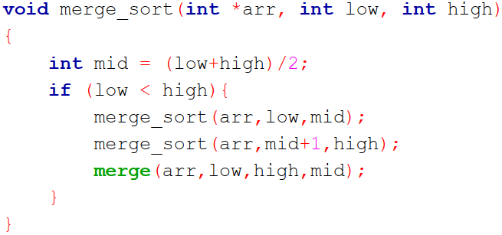
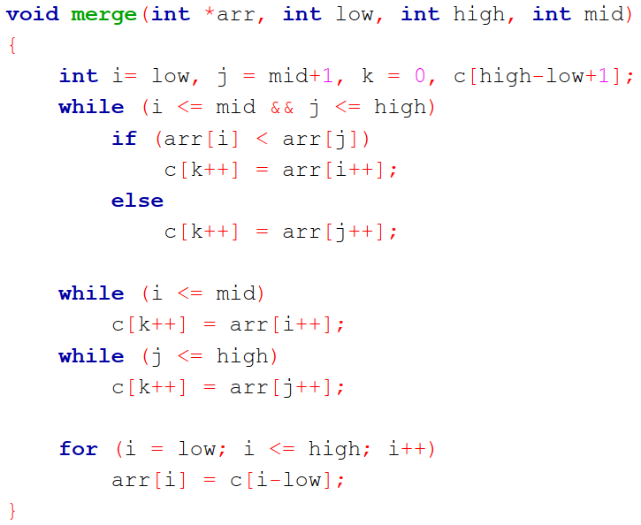
Merge Sort Algorithm
Step 1 − if it is only one element in the list it is already sorted, return.
Step 2 − divide the list recursively into two halves until it can no more be divided.
Step 3 − merge the smaller lists into new list in sorted order.

Slide 19
Merge-Sort Tree
An execution of merge-sort is depicted by a binary tree
each node represents a recursive call of merge-sort and stores
unsorted sequence before the execution and its partition
sorted sequence at the end of the execution
the root is the initial call
the leaves are calls on subsequences of size 0 or 1
7 2 ⏐ 9 4 → 2 4 7 9
7 ⏐ 2 → 2 7
9 ⏐ 4 → 4 9
7 → 7
2 → 2
9 → 9
4 → 4
19
Notes:
19

Slide 20
Execution Example
Partition
7 2 9 4 ⏐ 3 8 6 1
2 4 7 9
1 3 6 8
1 2 3 4 6 7 8 9
20
Notes:
20

Slide 21
Execution Example
Partition
7 2 9 4 ⏐ 3 8 6 1
21
Notes:
21

Slide 22
Execution Example (cont.)
Recursive call, partition
7 2 9 4 ⏐ 3 8 6 1
7 2 ⏐ 9 4
22
Notes:
22

Slide 23
Execution Example (cont.)
Recursive call, partition
7 2 9 4 ⏐ 3 8 6 1
7 2 ⏐ 9 4
7 ⏐ 2
23

Slide 24
Execution Example (cont.)
Recursive call, base case
7 2 9 4 ⏐ 3 8 6 1
7 2 ⏐ 9 4
7 ⏐ 2
7 → 7
24

Slide 25
Execution Example (cont.)
Recursive call, base case
7 2 9 4 ⏐ 3 8 6 1
7 2 ⏐ 9 4
7 ⏐ 2
7 → 7
2 → 2
25

Slide 26
Execution Example (cont.)
Merge
7 2 9 4 ⏐ 3 8 6 1
7 2 ⏐ 9 4
7 ⏐ 2 → 2 7
7 → 7
2 → 2
26

Slide 27
Execution Example (cont.)
Recursive call, …, base case, merge
7 2 9 4 ⏐ 3 8 6 1
7 2 ⏐ 9 4
7 ⏐ 2 → 2 7
9 4 → 4 9
7 → 7
2 → 2
9 → 9
4 → 4
27

Slide 28
Execution Example (cont.)
Merge
7 2 9 4 ⏐ 3 8 6 1
7 2 ⏐ 9 4 → 2 4 7 9
7 ⏐ 2 → 2 7
9 4 → 4 9
7 → 7
2 → 2
9 → 9
4 → 4
28

Slide 29
Execution Example (cont.)
Recursive call, …, merge, merge
7 2 9 4 ⏐ 3 8 6 1
7 2 ⏐ 9 4 → 2 4 7 9
3 8 6 1 → 1 3 6 8
7 ⏐ 2 → 2 7
9 4 → 4 9
3 8 → 3 8
6 1 → 1 6
7 → 7
2 → 2
9 → 9
4 → 4
3 → 3
8 → 8
6 → 6
1 → 1
29

Slide 30
Execution Example (cont.)
Merge
7 2 9 4 ⏐ 3 8 6 1 → 1 2 3 4 6 7 8 9
7 2 ⏐ 9 4 → 2 4 7 9
3 8 6 1 → 1 3 6 8
7 ⏐ 2 → 2 7
9 4 → 4 9
3 8 → 3 8
6 1 → 1 6
7 → 7
2 → 2
9 → 9
4 → 4
3 → 3
8 → 8
6 → 6
1 → 1
30

Slide 31
Mergesort(A)
{
n = length(A)
if(n<2) return
mid = n/2
L = array of size(mid)
R = array of size(n-mid)
for(i=0; i < mid; i++)
L[i] = A[i]
for(i=mid; i < n; i++)
R[i-mid] = A[i]
Mergesort(L)
Mergesort(R)
Merge(L , R , A)
}
7 2 9 4 ⏐ 3 8 6 1 → 1 2 3 4 6 7 8 9
7 2 ⏐ 9 4 → 2 4 7 9
3 8 6 1 → 1 3 6 8
7 ⏐ 2 → 2 7
9 4 → 4 9
3 8 → 3 8
6 1 → 1 6
7 → 7
2 → 2
9 → 9
4 → 4
3 → 3
8 → 8
6 → 6
1 → 1
31

Slide 32
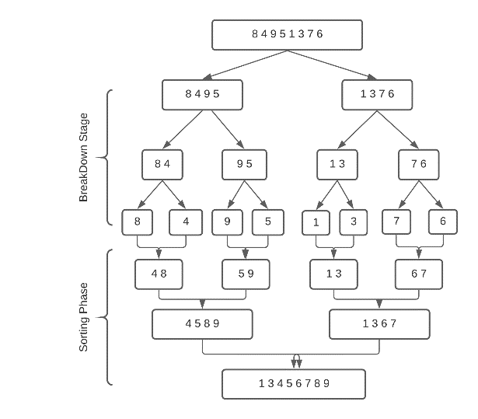

Slide 33
Exercise
98
23
45
14
6
67
33
42

Slide 34
Merge Sort Analysis
The divide step takes constant time, regardless of the subarray size. After all, the divide step just computes the midpoint q of the indices p and r. Recall that in big-O notation, we indicate constant time by O(1).
The conquer step, where we recursively sort two subarrays of approximately n/2 elements each, takes some amount of time, but we'll account for that time when we consider the subproblems.
The combine step merges a total of n elements, taking O(n) time.

Slide 35
Mergesort(A) { | T(n), to sort n elements
n = length(A) if(n<2) return mid = n/2 L = array of size(mid) R = array of size(n-mid) | c
for(i=0; i < mid; i++) L[i] = A[i] for(i=mid; i < n; i++) R[i-mid] = A[i] | c2* (n/2) + c2* (n/2) =c2( n/2 + n/2) =c2 * n
Mergesort(L) | T(n/2)
Mergesort(R) | T(n/2)
Merge(L , R , A) | c3.n+c4
}
So, T(n) = O(1) when n = 1, and 2T(n/2) + (c2+c3)*n + (c1+c4) when n > 1

Slide 36

So $T\left(n\right)= 2T\left(\frac{n}{2}\right)+ \left(c2+c3\right)∗n + \left(c1+c4\right)$
$$=2T(\frac{n}{2}) + c’∗n + c’’$$
So, for merge sort:

Slide 37
Merge Sort Analysis
Repeated Substitution Method

Slide 38
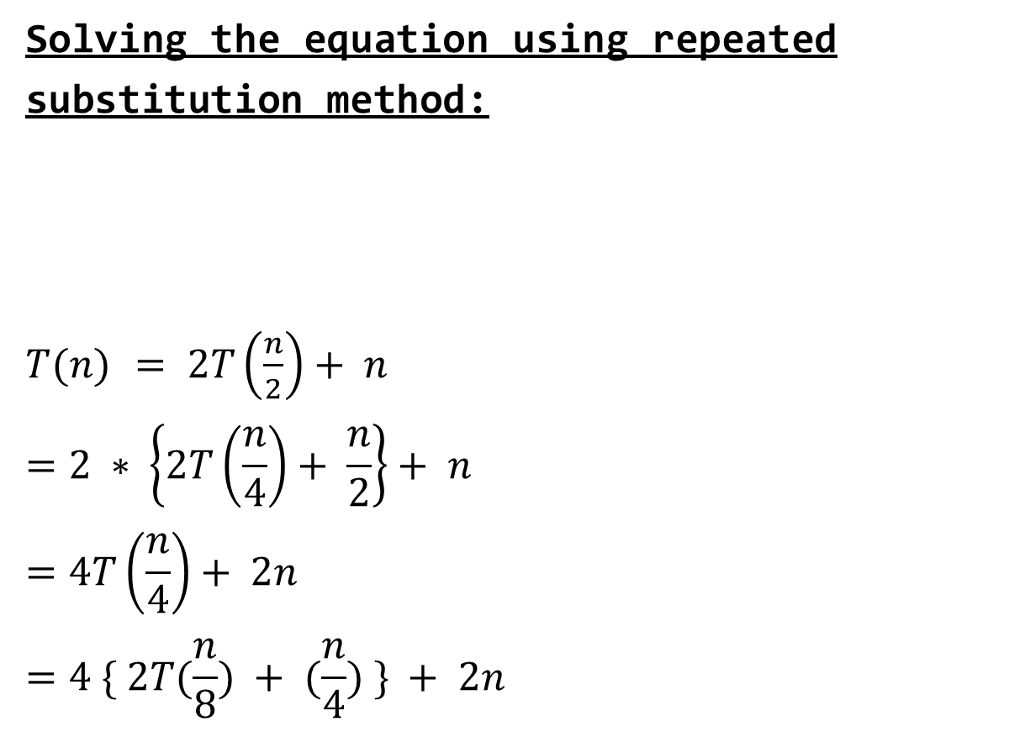
Solving the equation using repeated substitution method:
$T(n)$ $= 2T\left(\frac{n}{2}\right)+ n$
$$=2 ∗ \left\{2T\left(\frac{n}{4}\right)+ \frac{n}{2}\right\}+ n$$
$$=4T\left(\frac{n}{4}\right)+ 2n$$
$$=4 \{ 2T(\frac{n}{8}) + (\frac{n}{4}) \} + 2n$$

Slide 39

$$= 8T(\frac{n}{8}) + 3n$$
$$= 8 \left\{ 2T\left(\frac{n}{16}\right)+\left(\frac{n}{8}\right)\right\}+ 3n$$
$$= 16T(\frac{n}{16}) + 4n$$
$$= 2^{4} T \left(\frac{n}{2^{4}}\right)+4n$$
$= 2^{k} T \left(\frac{n}{2^{k} }\right)+kn$ [$k=4$]
$$Let, \frac{n}{2^{k} } = 1$$
$2^{k} = n$
$k =\log{2}n$ = log n

Slide 40

$$= 2^{k} T \left(\frac{n}{2^{k} }\right)+kn$$
$$=n T \left(1\right)+log n∗n$$
$$=n+ n log n$$
$$Time complexity$$
$$O( n + n log n)$$
$$= O( n∗logn)$$

Slide 41
Merge Sort Analysis
Recursion Tree Method

Slide 42
Recursion-tree Method
Show successive expansions of recurrences using trees.
Keep track of the time spent on the subproblems of a divide and conquer algorithm.
Help organize the algebraic bookkeeping necessary to solve a recurrence.

Slide 43
Recursion Tree for Merge Sort
For the original problem, we have a cost of cn, plus two subproblems each of size (n/2) and running time T(n/2).
Each of the size n/2 problems has a cost of cn/2 plus two subproblems, each costing T(n/4).
cn
cn
Cost of divide and merge.
cn/2
cn/2
T(n/2)
T(n/2)
T(n/4)
T(n/4)
T(n/4)
T(n/4)
Cost of sorting subproblems.

Slide 44
Recursion Tree for Merge Sort
Continue expanding until the problem size reduces to 1.
cn
Each level has total cost cn.
Each time we go down one level, the number of sub-problems doubles, but the cost per sub-problem halves ⇒ cost per level remains the same.
There are lg n + 1 levels, height is lg n. (Assuming n is a power of 2.)
Total cost = sum of costs at each level = (lg n + 1)cn = cnlgn + cn = O(n lgn).
cn/2
cn/2
cn/4
cn/4
cn/4
cn/4
c
c
c
c
c
c

Slide 45


Recursion Tree for Merge Sort
n
$$\frac{n}{2}$$
$$\frac{n}{2}$$
c.n

Slide 46







Recursion Tree for Merge Sort
n
$$\frac{n}{2}$$
$$\frac{n}{2}$$
c.n
$$\frac{n}{4}$$
$$\frac{n}{4}$$
$$\frac{n}{4}$$
$$\frac{n}{4}$$
c. $\frac{n}{2}$ + c. $\frac{n}{2}$
=c.n
Each level has total cost c*n.
Each time we go down one level, the number of subproblems doubles, but the cost per subproblem halves ⇒ cost per level remains the same.

Slide 47
















Recursion Tree for Merge Sort
n
$$\frac{n}{2}$$
$$\frac{n}{2}$$
c.n
$$\frac{n}{4}$$
$$\frac{n}{4}$$
$$\frac{n}{4}$$
$$\frac{n}{4}$$
c. $\frac{n}{2}$ + c. $\frac{n}{2}$
=c.n
$$\frac{n}{8}$$
$$\frac{n}{8}$$
$$\frac{n}{8}$$
$$\frac{n}{8}$$
$$\frac{n}{8}$$
$$\frac{n}{8}$$
$$\frac{n}{8}$$
$$\frac{n}{8}$$
c. $\frac{n}{4}$ + c. $\frac{n}{4}$ + c. $\frac{n}{4}$ + c. $\frac{n}{4}$
=c.n

Slide 48
Recursion Tree for Merge Sort
n
$$\frac{n}{2}$$
$$\frac{n}{2}$$
=c.n
$$\frac{n}{4}$$
$$\frac{n}{4}$$
$$\frac{n}{4}$$
$$\frac{n}{4}$$
=c.n
$$\frac{n}{8}$$
$$\frac{n}{8}$$
$$\frac{n}{8}$$
$$\frac{n}{8}$$
$$\frac{n}{8}$$
$$\frac{n}{8}$$
$$\frac{n}{8}$$
$$\frac{n}{8}$$
=c.n

Slide 49














Recursion Tree for Merge Sort
n=8
$$\frac{n}{2}$$
$$\frac{n}{2}$$
c.n
$$\frac{n}{4}$$
$$\frac{n}{4}$$
$$\frac{n}{4}$$
$$\frac{n}{4}$$
=c.n
$$\frac{8}{8}$$
$$\frac{8}{8}$$
$$\frac{8}{8}$$
$$\frac{8}{8}$$
$$\frac{8}{8}$$
$$\frac{8}{8}$$
$$\frac{8}{8}$$
$$\frac{8}{8}$$
=c.n

Slide 50




























Recursion Tree for Merge Sort
n=8
n=8
$$\frac{n}{2}$$
$$\frac{n}{2}$$
$$\frac{n}{2}$$
c.n
$$\frac{n}{2}$$
$$\frac{n}{4}$$
$$\frac{n}{4}$$
=c.n
$$\frac{n}{4}$$
$$\frac{n}{4}$$
$$\frac{n}{4}$$
$$\frac{n}{4}$$
$$\frac{n}{4}$$
$$\frac{n}{4}$$
$$\frac{8}{8}$$
$$\frac{8}{8}$$
$$\frac{8}{8}$$
$$\frac{8}{8}$$
$$\frac{8}{8}$$
$$\frac{8}{8}$$
$$\frac{8}{8}$$
$$\frac{8}{8}$$
$\frac{8}{8}$=1
$\frac{8}{8}$=1
$\frac{8}{8}$=1
$\frac{8}{8}$=1
$\frac{8}{8}$=1
$\frac{8}{8}$=1
$\frac{8}{8}$=1
$\frac{8}{8}$=1
=c.n
Continue expanding until the problem size reduces to 1.
So , if n=8 we need 3cn

Slide 51
n=8 | 3 levels | we need 3.cn
n=16 | 4 levels | we need 4.cn
n=32 | 5 levels | we need 5.cn
n=64 | 6 levels | we need 6.cn

Slide 52
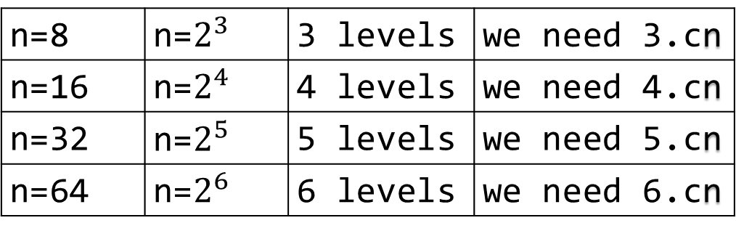
n=8 | n=$2^{3}$ | 3 levels | we need 3.cn
n=16 | n=$2^{4}$ | 4 levels | we need 4.cn
n=32 | n=$2^{5}$ | 5 levels | we need 5.cn
n=64 | n=$2^{6}$ | 6 levels | we need 6.cn

Slide 53
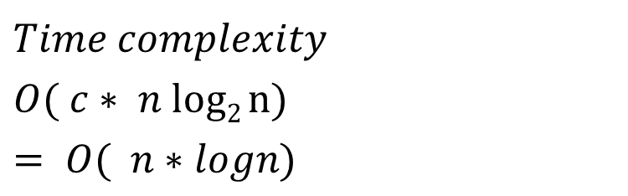
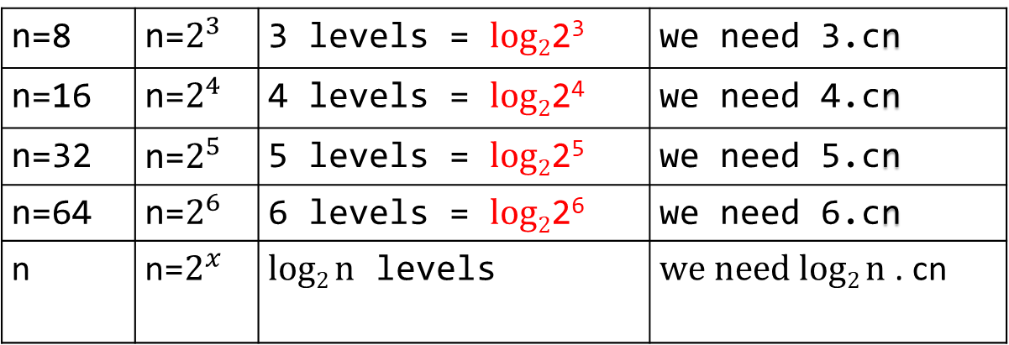
n=8 | n=$2^{3}$ | 3 levels = $log2$2³ | we need 3.cn
n=16 | n=$2^{4}$ | 4 levels = $log2$2⁴ | we need 4.cn
n=32 | n=$2^{5}$ | 5 levels = $log2$2⁵ | we need 5.cn
n=64 | n=$2^{6}$ | 6 levels = $log2$2⁶ | we need 6.cn
n | n=$2^{x}$ | $log2 n$ levels | $we need log2 n$ . cn
$$Time complexity$$
$$O( c∗ n log2 n)$$
$$= O( n∗logn)$$

Slide 54
Merge Sort Analysis
Recursion Tree Method
(another way!!)

Slide 55
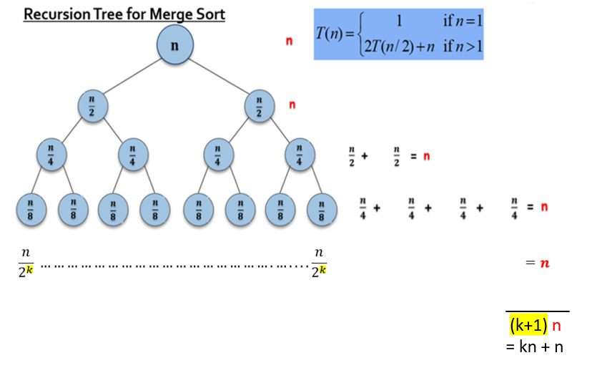

Slide 56
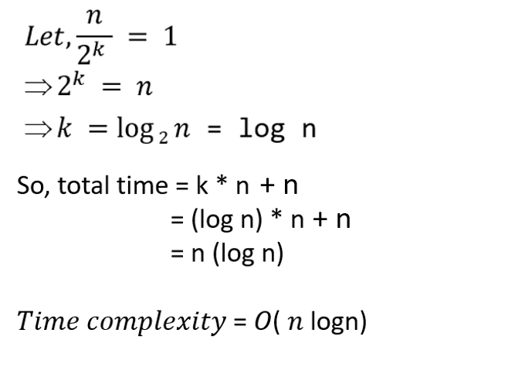

Slide 57
Merge Sort Analysis
Master Method

Slide 58
The master method applies to recurrences of the form
T(n) = a T(n/b) + f (n) ,
where a ≥ 1, b > 1, and f is asymptotically positive.

Slide 59
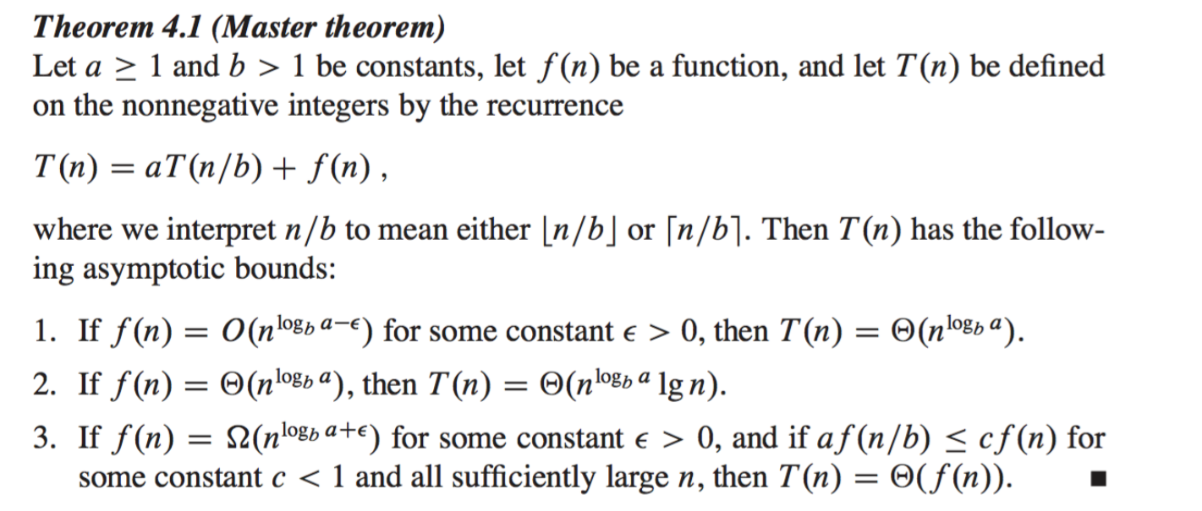

Slide 60
For case 1:
If f(n) < n^{logba},
Then T(n) = θ (n^{logba})
For case 2:
If f(n) = n^{logba},
Then T(n) = θ (n^{logba} logn)
For case 3:
If f(n) > n^{logba},
Then T(n) = θ(f(n))
and we must check the regularity condition-
af(n/b) <= cf(n) [c<1]

Slide 61
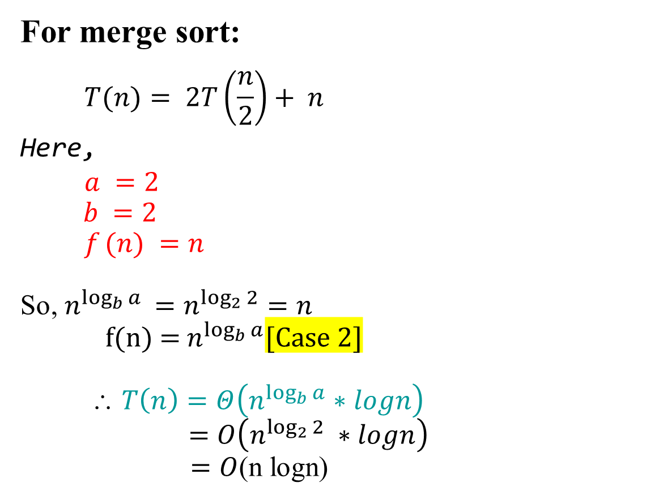
For merge sort:
$$T(n)= 2T\left(\frac{n}{2}\right)+ n$$
Here,
$$a =2$$
$b =2$
$$f (n) =n$$
So, $n^{\log_{b}{a}} =n^{\log_{2}{2}}=n$
f(n) = $n^{\log_{b}{a}}$[Case 2]
$$ T\left(n\right)=Θ\left(n^{\log_{b}{a}}∗logn\right)$$
$=O\left({n^{\log_{2}{2}}}^{ }∗logn\right)$
$=O$(n logn)

Slide 62
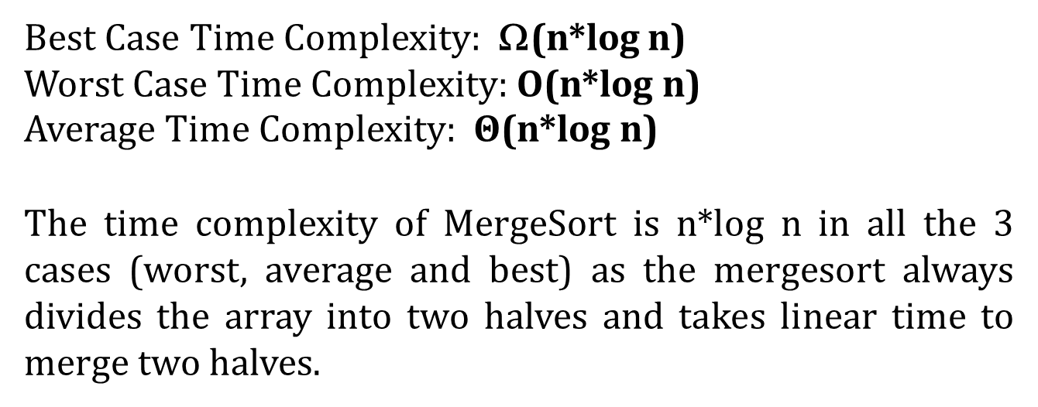
Best Case Time Complexity: Ω(n*log n)
Worst Case Time Complexity: O(n*log n)
Average Time Complexity: $Θ$(n*log n)
The time complexity of MergeSort is n*log n in all the 3 cases (worst, average and best) as the mergesort always divides the array into two halves and takes linear time to merge two halves.

Slide 63
Books
Introduction to Algorithms, Thomas H. Cormen, Charle E. Leiserson, Ronald L. Rivest, Clifford Stein (CLRS).
Fundamental of Computer Algorithms, Ellis Horowitz, Sartaj Sahni, Sanguthevar Rajasekaran (HSR)

Slide 64
References
https://www.google.com/search?q=bubble+sort+step+by+step&sxsrf=ALeKk01uxzgfT3Oy6k1Q3WxVnSpiIN8_4g:1587999728942&tbm=isch&source=iu&ictx=1&fir=vRwFsGwVfJ6pJM%253A%252CSzhhze6MPQr4cM%252C_&vet=1&usg=AI4_-kSrEEXqwRL-PkHhVUtn7jNfF9dB6g&sa=X&ved=2ahUKEwje0Pz974jpAhXRAnIKHWhMD2UQ_h0wAXoECAcQBg#imgrc=EN4Sdu7veOWVoM&imgdii=eOqvCu85p9-eBM
https://www.interviewcake.com/concept/java/counting-sort
https://www.geeksforgeeks.org/counting-sort/
https://www.hackerearth.com/practice/algorithms/sorting/quick-sort/tutorial/

